Slide 1
#semantic #interoperability #IOT2018

Slide 2
Semantics Web provides languages and tools to reach Semantic Interoperability
Learning curve for industrial practitioners is still steep
Simple ontologies and clear guidelines are required
Several organizations develop ontologies to describe IoT devices and the data they exchange (W3C SSN, W3C WoT, ETSI SmartM2M, ETSI ISG CIM, BAC.net, KNX, BRICK, …)
SIS-IoT: current trends and challenges in Semantic Interoperability and Standardization in IoT
#semantic #interoperability #IOT2018

Slide 3
Organization
https://iot2018wt.github.io/sis-iot/
Organizers
Laura Daniele
TNO, NL
Anna Fensel
University of Innsbruck, Austria
Raúl García-Castro
Ontology Engineering Group
Universidad Politécnica de Madrid, Spain
Maxime Lefrançois
MINES Saint-Étienne, France.
Program committee
Nicolas Seydoux, LAAS
Victor Charpenay, Siemens AG
Kris McGlinn, Trinity College Dublin
Achille Zappa, Insight
Krzysztof Janowicz, UCSB
#semantic #interoperability #IOT2018

Slide 4
Program
https://iot2018wt.github.io/sis-iot/#program
9:00-9:15 |  | Introduction to SIS-IoT 2018
9:15-10:00 | Keynote | Krzysztof Janowicz, SOSA for Social Sensing.
10:00-10:30 | Long | Rami Belkaroui, Christophe Nicolle and Aurélie Bertaux. Towards Events Ontology Based on Data Sensors Network for Viticulture Domain.
10:30-11:00 |  | Break
11:00-11:30 | Long | Maxime Lefrançois. RDF Presentation and Correct Content Conveyance for Legacy Services and the Web of Things.
11:30-11:50 | Short | Michele Blank, Haifa Lahbaiel, Sebastian Kaebisch and Harald Kosch. Role Models and Lifecycles in IoT and their Impact on the W3C WoT Thing Description.
11:50-12:10 | Short | Sergio José Rodríguez Méndez. Modeling Actuations in BCI-O: A Context-based Integration of SOSA and IoT-O.
12:10-12:30 |  | Discussion
#semantic #interoperability #IOT2018

Slide 5
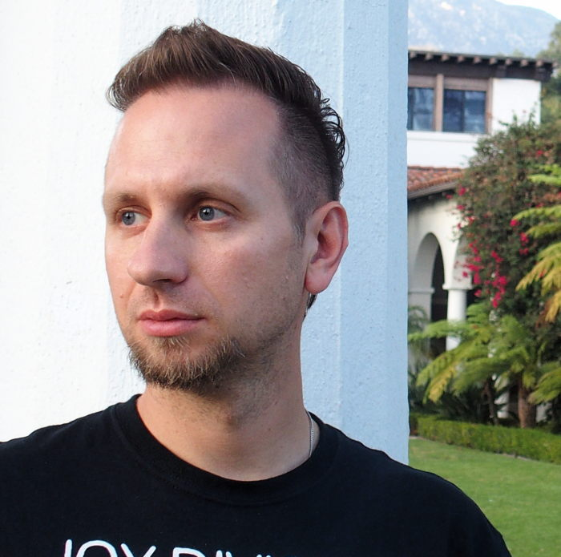
Keynote
Krzysztof Janowicz
University of California, Santa Barbara
SOSA for Social Sensing
#semantic #interoperability #IOT2018

